Slide 1


Slide 2

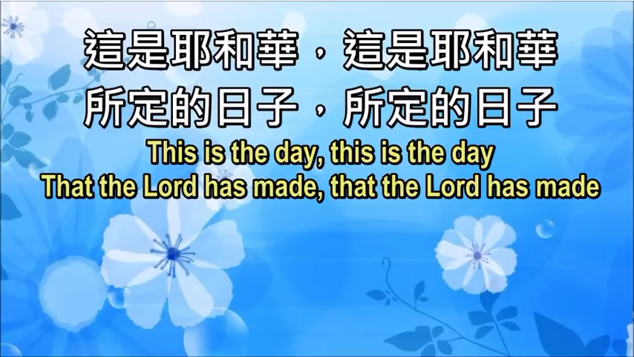
1-1

Slide 3
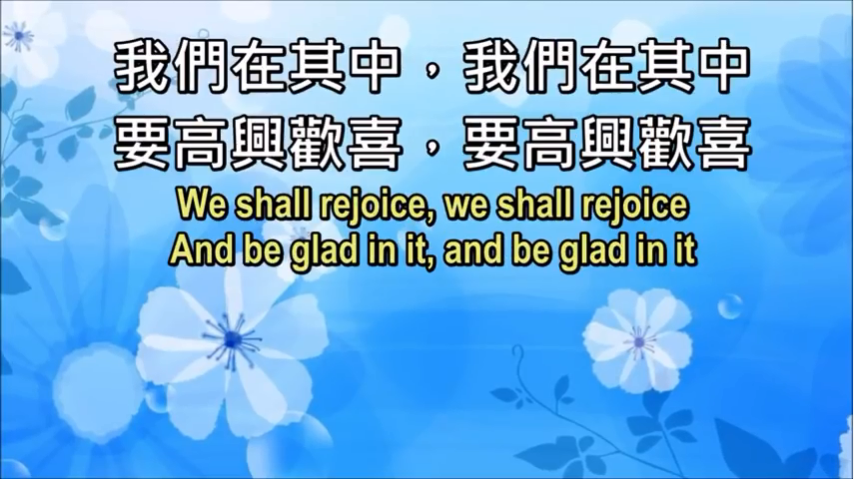
1-2

Slide 4

1-3

Slide 5

1-4

